Slide 1


Skill4ge - Learn Without Limits
STUDENT
E-LEARNING PLATFORM
SOFTWARE DESIGN PATTERN
CSE AIML
III YEAR

Slide 2

TEAM MEMBERS
SANTHOSH B - 727822TUAM049
PRAVEEN KUMAR V - 727822TUAM041
YOGA NARASIMMAN S - 727822TUAM063
SANJEY GM - 727822TUAM048

Slide 3


OVERVIEW
1
Introduction
6
Front End - Implementation
2
Technology Stack
7
Back End - Implementation
3
Flow Chart
8
Integration
4
Problem Statement
9
Conclusion
5
Solutions

Slide 4

INTRODUCTION
This project is a comprehensive Student E- Learning Platform developed using React.js for the frontend, Spring Boot for the backend, and MySQL as the database. Seamlessly integrated through Axios, the platform offers an intuitive and interactive learning experience, ensuring efficient data management and real-time updates across the system.

Slide 5
TECHNOLOGY STACK
React Js
Spring Boot
MySQL
Component-Based Architecture | Microservice Architecture | Relational Database Management
Virtual DOM | Embedded Servers | Scalability
State Management | Dependency Injection | Performance Optimization
Rich Ecosystem | Comprehensive Support | Open Source

Slide 6
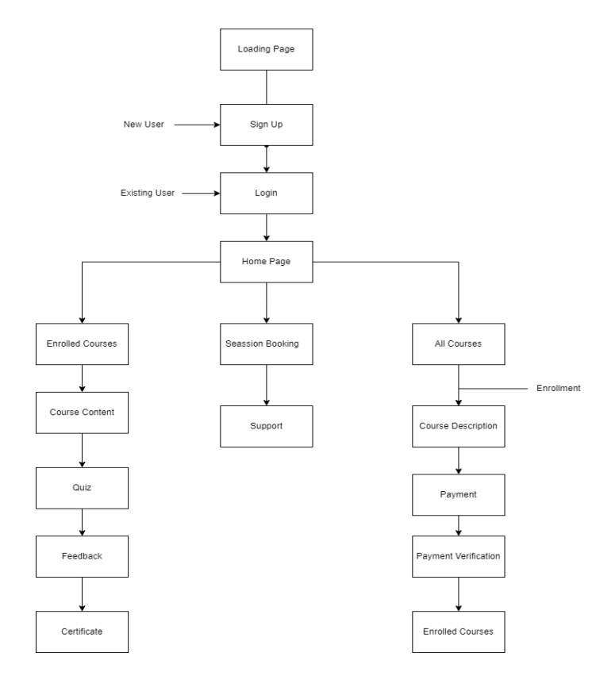
FLOW CHART

Slide 7

FEATURES
Interactive Support and Help Center
Intuitive User Interface
Integrated Feedback Mechanism
Easy Certification Process
Features a built-in help center with interactive guides, tutorials, and live chat support to assist users with any questions or issues promptly.
Offers a clean, easy-to-navigate interface that ensures a seamless user experience for students and instructors alike.
Allows students to provide instant feedback on courses and instructors, ensuring continuous improvement and responsiveness to user needs.
Simplifies the certification process with automated issuance of digital certificates upon course completion, allowing users to easily download and share their achievements.

Slide 8
Inconsistent Learning Resources:
Inconsistent Learning Resources: Students frequently encounter inconsistent or outdated learning materials across different courses and platforms, leading to confusion and gaps in knowledge.
Inefficient Certification Process:
PROBLEM STATEMENT
The process for earning and managing certifications on many eLearning platforms is often cumbersome and manual, causing delays and administrative overhead for both students and institutions.

Slide 9



SOLUTIONS
Automated Certification System:
Unified Resource Repository:
Implement an automated certification system that streamlines the issuance of digital certificates upon course completion. This system will allow students to easily download and share their achievements, while reducing administrative burden and ensuring timely and accurate certification management.
Create a unified resource repository where all learning materials, including lectures, articles, and multimedia content, are regularly updated and accessible in a centralized location. This ensures that students have access to consistent and up-to-date resources, enhancing the overall learning experience.

Slide 10


FRONT END IMPLEMENTATION
REACT
Developed dynamic user interfaces using React.js, including components for login, signup, and protected routes. Components manage user input, interact with authentication services, and handle navigation based on authentication status.
CSS
Applied custom styles to enhance the visual appeal and usability of the application. Ensured responsive design for consistent user experiences across devices.

Slide 11


BACK END IMPLEMENTATION
SPRING BOOT
Utilized Spring Boot to develop a robust and scalable backend for the application. Implemented RESTful APIs to handle client requests and manage application logic.
MYSQL
Integrated MySQL for reliable and structured data storage. Configured the database to efficiently handle user data, course information, and other application-related data.

Slide 12


INTEGRATION
FRONTEND AND BACKEND COMMUNICATION
AXIOS
Utilized Axios in the React.js frontend to send HTTP requests to the Spring Boot backend. This setup enables seamless data exchange between the client-side application and server-side services.
JWT AUTHENTICATION
Implemented JWT-based authentication to manage secure access. The frontend sends the JWT in the request headers, and the backend validates it to authenticate and authorize users.

Slide 13
CONCLUSION
The development of the eLearning platform successfully integrates a React.js frontend with a Spring Boot backend, supported by a MySQL database and JWT-based authentication. The frontend provides a dynamic and responsive user experience, while Axios facilitates seamless communication with the backend. The backend, powered by Spring Boot and secured with JWT, ensures robust data management and secure user authentication. This cohesive integration delivers a reliable, scalable, and user-friendly platform, enhancing the overall learning experience and meeting modern educational needs.

